Slide 1
How to adapt the VITbox files and create your own materials
CEFR Companion Volume implementation toolbox
Implémentation du Volume complémentaire du CECR – Boîte d’outils
© 2023. This work is licensed under an Attribution-NonCommercial-ShareAlike International Creative Commons CC-BY-NC-SA 4.0 License. Attribution: Original activity from Fischer Johann (et al.) (2023), CEFR Companion Volume implementation toolbox, Council of Europe (European Centre for Modern Languages), Graz, available at www.ecml.at/companionvolumetoolbox.

Slide 2
Teacher educator activities – part 2
Choosing useful VITbox files
Adapting the files
Creating additional resources
Using the files
Collecting feedback
Revising the resources

Slide 3
How to adapt
Adapting resources of a specific module:
change text
replace recording
delete / add slides
make your own recording
create a new video
Producing new material using elements from different VITbox modules:
use elements from different VITbox modules
put them together in a new PowerPoint
add additional elements
create a new video

Slide 4
Our example: Workshop on task development
Adapt the files to be used in a professional development workshop that aims at:
familiarising future teachers with the development of a task-based examination, applying the action-oriented approach

Slide 5
The VITbox website at: www.ecml.at/companionvolumetoolbox
The action-oriented approach and the learner as a social agent

Slide 6
Example: The action-oriented approach
Detailed video
Template
Checklist

Slide 7
Example: Adapting the module on the action-oriented approach
Adapting the (recorded) PowerPoint

Slide 8
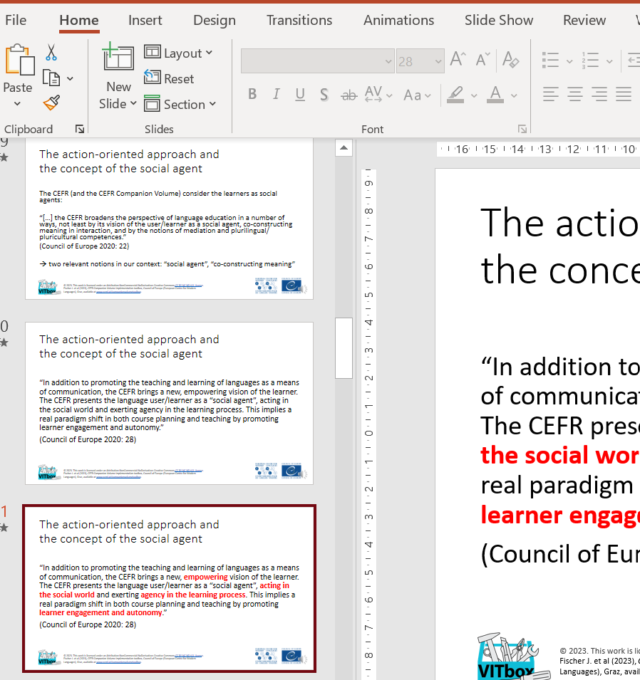
Changing the PowerPoint, e.g.:
deleting slides

Slide 9
Changing the PowerPoint, e.g.:
adapting slides

Slide 10
Changing the PowerPoint, e.g.:
adapting slides

Slide 11
Changing the PowerPoint, e.g.:
adapting slides

Slide 12
Changing the PowerPoint, e.g.:
adapting slides:
changing audio text

Slide 13
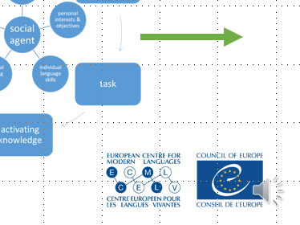
Changing the PowerPoint, e.g.:
adapting slides:
changing audio text
adding new audio text

Slide 14
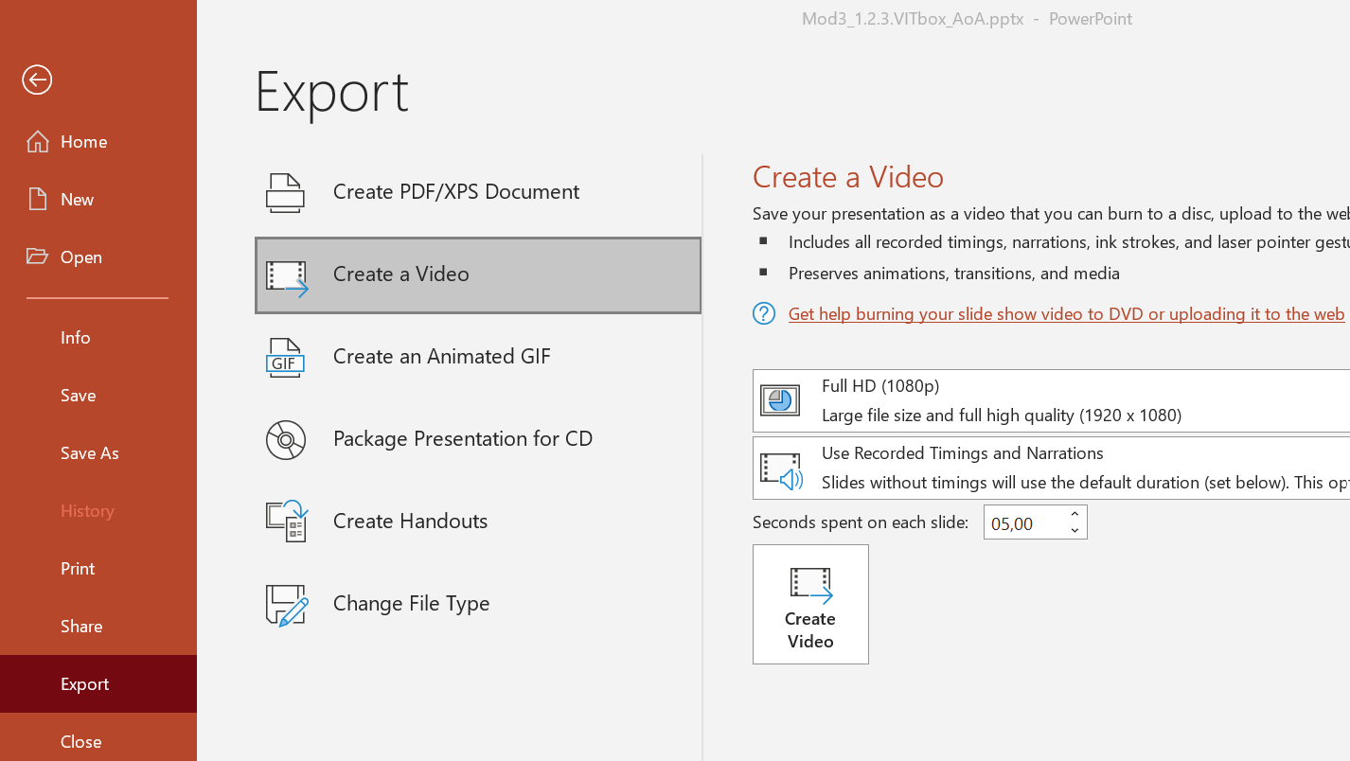
Creating your new video (MP4 file)

Slide 15
Creating your new video
The new video is ready for use!

Slide 16
Using elements from different VITbox modules
Example: You want to run a 90 minute workshop on mediation and would like to familiarise teacher trainees with:
The innovative aspects of the CEFR Companion (as an introduction)
Information about the four modes of communication
More detailed information on mediation
Information on how to assess mediation skills

Slide 17
Using elements from different VITbox modules
1. The innovative aspects of the CEFR Companion:
Use slides from the introductory PowerPoint to the innovative aspects of the CEFR Companion Volume
Select the two slides that provide an overview of the “new” aspects (slides 3 & 4)

Slide 18
Using elements from different VITbox modules
2. Information about the four modes of communication:
Use slides from the introductory PowerPoint presenting the concept of the four modes of communication
Decide which slides to use, e.g. slide 3, but maybe also slides 2, 4 & 5, or 6-9

Slide 19
Using elements from different VITbox modules
3. Information on mediation:
To start, you might use slides from the introductory PowerPoint presenting the concept of mediation in the Companion Volume
You may select slides you consider relevant
or you might use the entire PowerPoint
You might also take some slides from the other PowerPoint presentation dealing with mediation

Slide 20
Using elements from different VITbox modules
4. Assessment:
no specific VITbox module on assessment
but topic addressed in module on “Constructive alignment”
e.g.:
introductory PowerPoint
PowerPoint on designing tasks
PowerPoint on designing rating scales

Slide 21
Using elements from different VITbox modules
Final steps:
Put the slides into an order that is convenient for your workshop
Add additional slides
Option:
Record your own text
Create your own video

Slide 22
Using elements from different VITbox modules
See sample PDF file from a professional development course:
Professional development workshop run by Julia Zabala Delgado (Universitat Politècnica de València, Spain) at Masaryk University in Brno (Czech Republic) in 2022

Slide 23
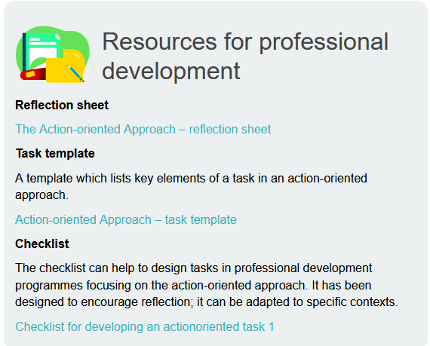
Teacher educator activities – next steps
Choosing useful VITbox files
Adapting the files
Creating additional resources
Using the files
Collecting feedback
Revising the resources

